Slide 1


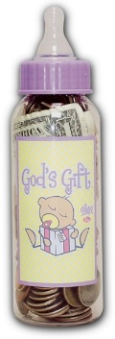

Change for Life Campaign
Pick up a bottle today!
Come alongside Crossroads Pregnancy Care
to bring Hope, Help, and Healing
to women and families in need.
Don’t want to fill a bottle?

